Slide 1


10 Functional Language Features Every Object-Oriented Programmer Should Crave
Ivan Towlson
GreenButton

Slide 2

EXPRESSIONS FOR EVERYTHING
10

Slide 3

UNIT
9

Slide 4
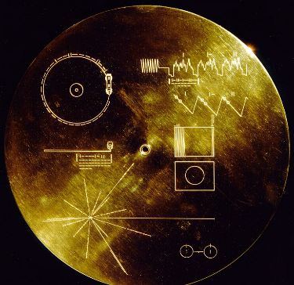
IMMUTABLE RECORDS
8

Slide 5
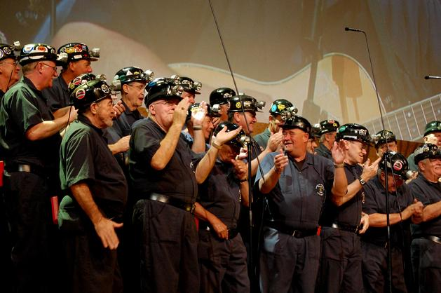
DISCRIMINATED UNIONS
7

Slide 6
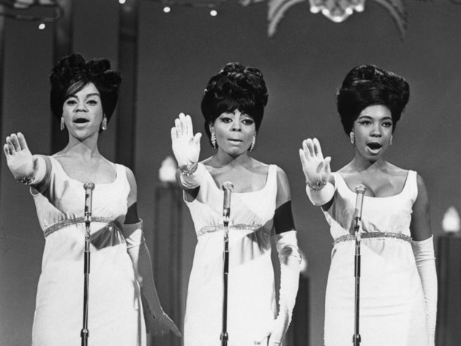
NON NULLABLE TYPES
6

Slide 7
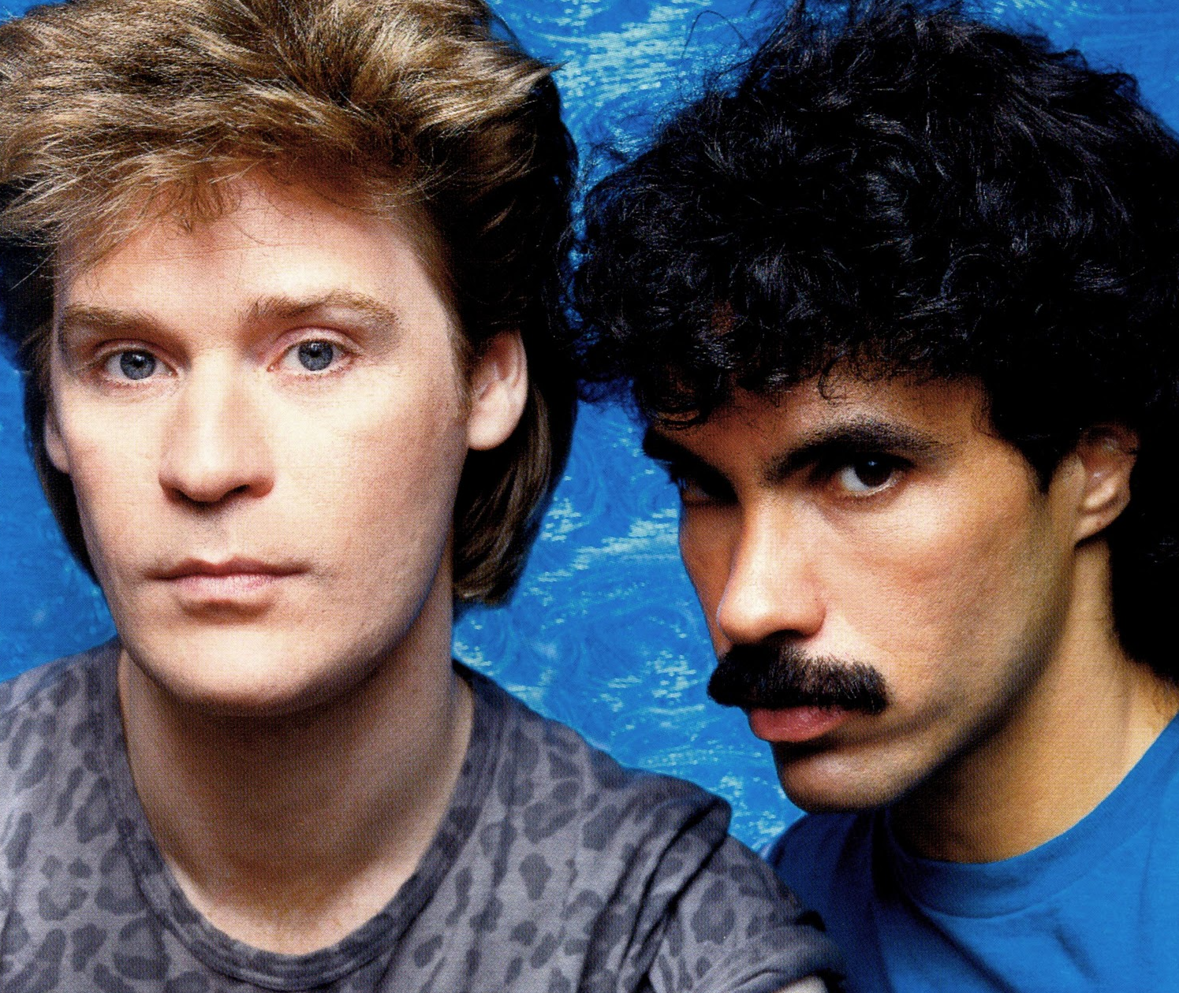
OPTION AND EITHER
5

Slide 8

TYPE INFERENCE
4

Slide 9
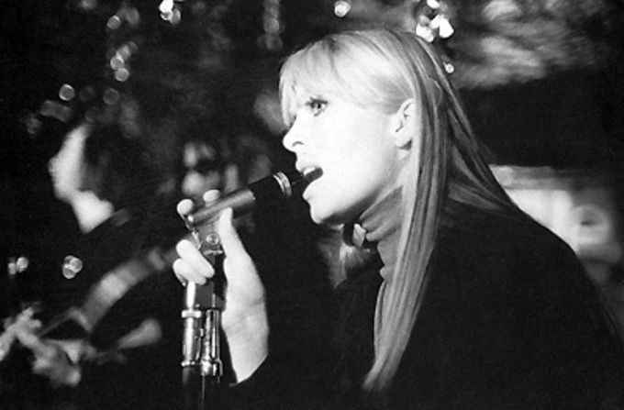
INFIX NOTATION
3

Slide 10
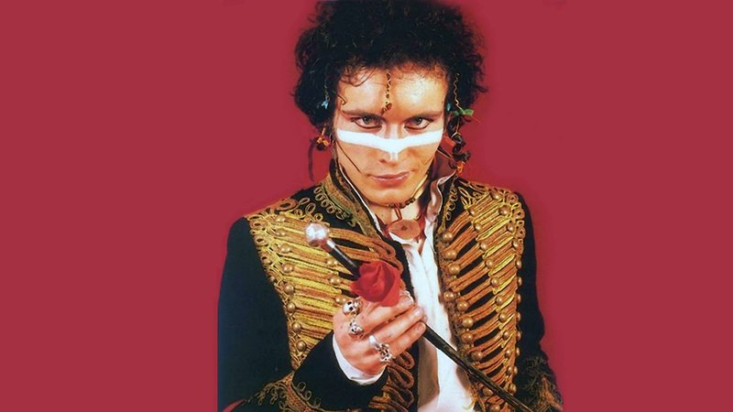
PARTIAL APPLICATION
2

Slide 11
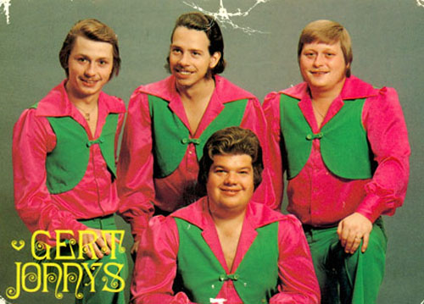
PATTERN MATCHING
1

Slide 12
ivan@hestia.cc http://hestia.typepad.com/flatlander @ppog_penguin ivan@greenbutton.com http://developer.greenbutton.com
THANKS

